Slide 1
Big Mountain
Resort: Ticket Price Adjustment
T. Hastings Reeves • 01.02.2021

Slide 2
Recent Additions to Big Mountain Resort
Chairlift Construction project
Completed January 2019
Operation costs
Increase of ~$1.54 million
Options in covering additional costs
Task and Analysis
-How does the ticket price of Big Mountain Resort compare to competitors?
-What amenities are necessary and where can resources be refocused to optimize value for customers?

Slide 3
Recommendations
Ticket Prices
An increase in ticket price of $4 is recommended.
There is room to adjust ticket prices and cover the cost of the current construction.
Ski Runs and Chair Lifts
The removal of up to 5 ski runs is acceptable with a reduction of $0.75 in ticket price.
The addition of one run that extends the vertical drop by 150 feet and adds an additional chair could lead to an increase of $3.4 million

Slide 4
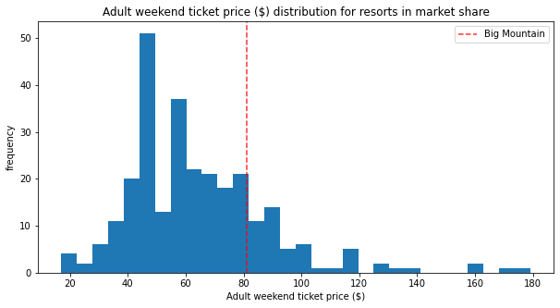
Ticket Prices - Comparisons
Competitors
When comparing the ticket price of the resort to competitor resorts, the results warranted a significant increase.
Based on current amenities, ticket price should range from $85.48-$95.47 for the resort

Slide 5
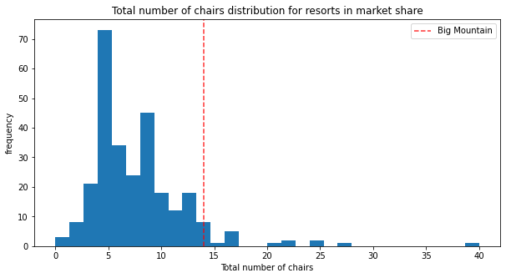
Chair Lifts
Increasing Chair totals
The previous construction project was a terrific idea and warrants a ticket increase.
Adding more chair lifts correlates strongly to an increase in ticket price.

Slide 6
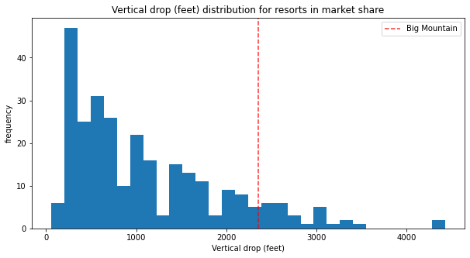
Vertical Drop
A tremendous asset
Big Mountain Resort’s Vertical Drop is near the top in comparison to all resorts nationally.
Strong correlation between ticket price increase and vertical drop.

Slide 7
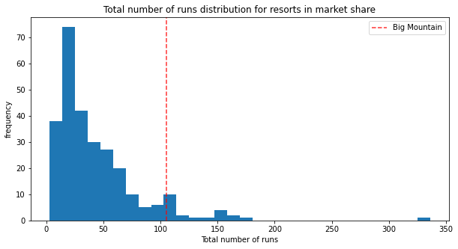
Removing ski runs
Possibilities
Compared to other resorts, Big Mountain is near the top in total number of runs.
The removal of runs can be risky in how it affects ticket price.

Slide 8
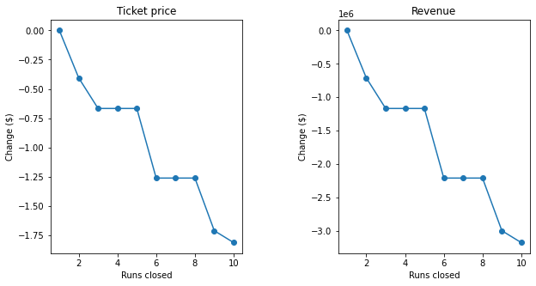
Removing ski runs
Risk of removing runs
Removing runs has various effects on ticket price depending on how many you remove.
There is a strong negative correlation between removing runs and decreasing revenue.

Slide 9
Resort Opportunities
An increase in ticket prices is warranted and should be strongly considered.
Additional ski runs and a chair lift could greatly increase the revenue.
Big Mountain Resort is at the top of the market in several key amenities and has many positive attractions to promote.

